Slide 1
Chapter 11
Two-Way ANOVA Factorial Design

Slide 2
Learning Objectives
Explain the concept of two-way ANOVA
Describe the principle and assumptions of two-way ANOVA
Design two-way ANOVA factorial experiment
Explain how the research problem is formulated for two-way ANOVA
Explain how the hypotheses are expressed in two-way ANOVA

Slide 3
Demonstrate the steps used in SPSS to execute two-way ANOVA
Explain how to analyse and interpret the SPSS outputs of two-way ANOVA
Describe the important formulae and calculations of main ANOVA table
Report the final results of two-way ANOVA

Slide 4
Introduction
Two-way ANOVA experiment is used for comparing the mean between two distinct independent variables called factors.
The experiment design is also called two-factorial design as the influence of two categorical factors is measured on one continuous-based dependent variable.
Two-way ANOVA is the most popular used experiment, aiming to ascertain the interaction effect of both independent variables on the dependent variable.
The analysis of interaction effects is an important factor for interpreting the results whether the effect of one independent variable on dependent variable is same along with the categories on the second independent variable.

Slide 5
Principle of Two-Way ANOVA
Total Variance in Sample
Treatment Effect
Variance Explained by Factor A
Variance Explained by Factor B
Random Effect
Interaction Effect due to A and B
The variation between the treatment (SS_{between}) is measured from the overall mean. The variation of SS_{between} is further partitioned into main effect of factor A (SS_{A}), main effect of factor B (SS_{B}), and joint effect of both factors (SS_{AB}).

Slide 6
Source of Variance: Two-Way ANOVA
Table 11.1. Source of Variance: Two-Way ANOVA
Source of Variance | Cause of Variability | Degree of Freedom (df) | Sum of Squares (SS) | Mean Sum of Squares (MS) | F-Statistics
Between-group variance (Due to factor-A) | Levels of factor-A | Levels of factor A-1 (df_{A}) | SS_{A} | MS_{A} = SS_{A}/ df_{A} | F_{A} = MS_{A}/MSE
Between-group variance (Due to factor-B) | Levels of factor-B | Levels of factor B-1 (df_{B}) | SS_{B} | MS_{B} = SS_{B}/ df_{B} | F_{B} = MS_{B}/MSE
Joint Effect (Due to factor A and B) | Interaction between A and B | df_{AB} = (df_{A}) × (df_{B}) | SS_{AB} | MS_{AB} = SS_{AB}/ df_{AB} | F_{AB} = MS_{AB}/MSE
With-in group error | Error variance | df_{error} = n− number of cells | SS_{error} | MSE = SS_{error}/ df_{error}

Slide 7
Assumptions for Two-Way ANOVA
Normal distribution data: The variable to be assumed as dependent for the experimental design is normal distributed in target population.
Homogeneity of variance: Equality of variance of dependent variable for each combination of the groups of two factors.
Random selection and independent observations: The sample should be collected randomly from the target population and the observations are independent to each other.

Slide 8
Data scale: Similar to one-way ANOVA, the dependent variable should be measured at continuous scale (interval or ratio), whereas the two independent variables as used in the experiment are categorical in nature.
Significant outliers: Outliers are referred to as the particular cases those are significantly different from the usual pattern of data set.

Slide 9
Summary of Assumptions
Table 11.2. Assumptions: Two-Way ANOVA
Assumptions | Examine Approach | Measures/Tests
Normal distribution | Graphical method | Histogram and box and whisker plot
 | Numerical method | Skewness and kurtosis
 |  | KS one sample and Shapiro–Wilk
Homogeneity of variance | Numerical method | Levene’s test
Independent observation | Methodological | Random selection of sample
Number of variables | Methodological | Two independent and one dependent variable
Data scale | Methodological | Dependent variable: Interval or ratio scale
 |  | Independent variable: Nominal scale
Absence of outliers | Graphical method | Box and whisker plot

Slide 10
Designing Experiment
The difference in the population mean can be interpreted with two types of treatment effects.
Main effect: It is individual main effect of both independent variables. It is also called the independent effect of each factor as similar to one-way ANOVA.
Interaction effect: Influence of one factor is different at the levels of another factor (Graham 2000). It occurs due to joint effect of both the factors.

Slide 11
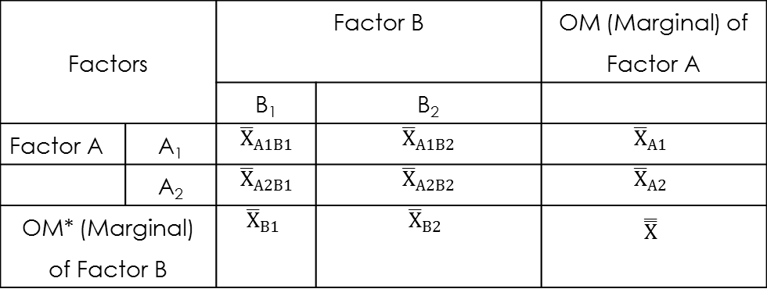
Table 11.3. Layout of Two-Way ANOVA
Factors |  | Factor B |  | OM (Marginal) of Factor A
 |  | B₁ | B₂
Factor A | A₁
 | A₂
OM* (Marginal) of Factor B

Slide 12
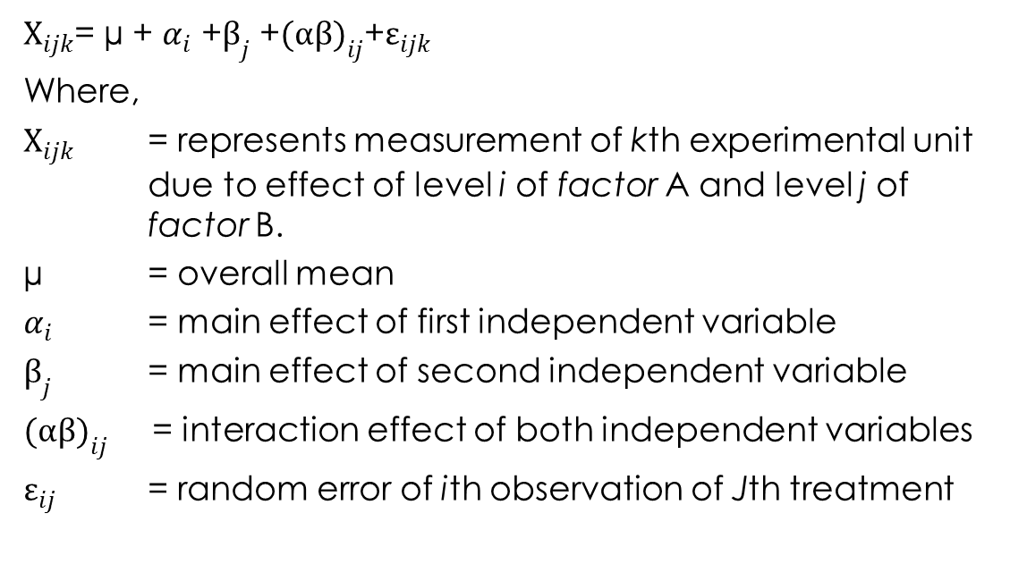
Notations Used in Two-Way ANOVA

Slide 13
Framing Hypothesis
Does factor A affect dependent variable?
Does factor B affect dependent variable?
Does the effect of factor A depend on the other independent variable?

Slide 14
Null Hypothesis H_{0A}: µ₁ = µ₂ = µ_{3 ………..} µ_{k} (k = Number of levels)
(There is no effect of factor A.)
Alternative hypothesis H_{aA}: µ₁ ≠ µ₂ ≠ µ₃ ≠ …….. µ_{k}
(There is an effect of factor A.)
Null hypothesis H_{0B}: µ₁ = µ₂ = µ_{3 ………..} µ_{k}
(There is no effect of factor B.)
Alternative hypothesis H_{aB}: µ₁ ≠ µ₂ ≠ µ₃ ≠…….. µ_{k}
(There is an effect of factor B.)
Null hypothesis H_{0(AxB)}: µ₁ = µ₂ = µ_{3………..} µ_{k}
(There is no effect of factor A and B.)
Alternative hypothesis H_{a(AxB)}: µ₁ ≠ µ₂ ≠ µ₃ ≠…….. µ_{k}
(There is an effect of factor A and B.)

Slide 15
Research Problem and Test Technique
In this experiment, the investigation is proposed to measure the main effect of gender and age on the number of friends by using the data set friend_list.sav.
Along with the main effect of each variable (gender and age), we are also interested to address whether the effect of gender is the same at different levels of age group of Facebook users.

Slide 16
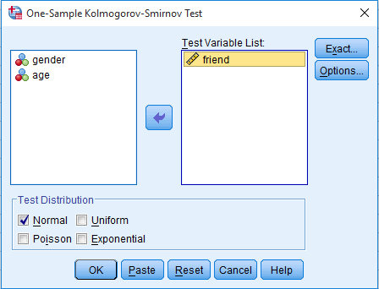
Executing Two-Way ANOVA with SPSS Procedure
Assessing Normality
Exhibit 11.1. Use friend_list.sav » Menu bar » analyse » Non-parametric test » Legacy Dialogs » One sample KS test » Transfer friend to Test Variable(s) List » Click on Normal distribution under Test Distribution » Click OK

Slide 17
Result of Normality Assessment
Table 11.4. Assessing Normality with One-Sample KS
Dependent Variable | N | Normal Parameters |  | K-S Z | Sig. (2-tailed)
 |  | Mean | Std. Deviation
Friend | 80 | 84.43 | 41.91 | 0.086 | 0.200
As the p-value of these observations are more than 0.05 (p > 0.05, 0.200) at 5% LoS, we fail to reject the null hypothesis about the condition of normality.

Slide 18
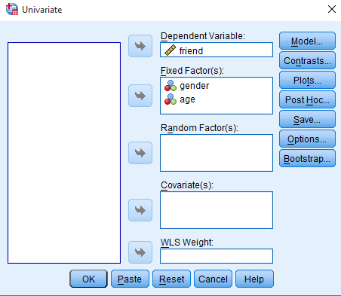
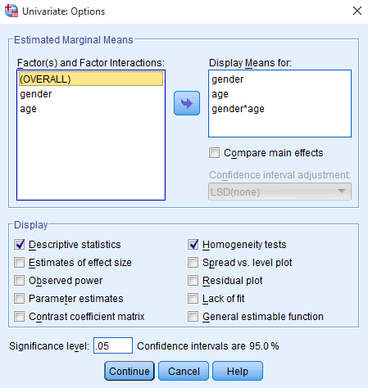
SPSS Path for Computing Descriptive Statistics, Homogeneity Test and Effect Size
Exhibit 11.2. Use friend_list.sav » Menu bar » analyse » General linear model » Univariate » Transfer friend in Dependent Variable box » Transfer gender and age (both by press shift button) in box Fixed Factor » Click Options » Transfer gender, age and gender x age in box Displays Mean for » Select Descriptive statistics and Homogeneity test in Display column » Continue

Slide 19
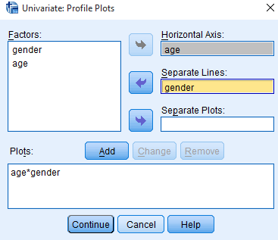
SPSS Path for Computing Profile Plot
Exhibit 11.3. Click Plots » Select » gender and transfer in Separate Lines » Select age and transfer in Horizontal Axis » Click on Add button

Slide 20
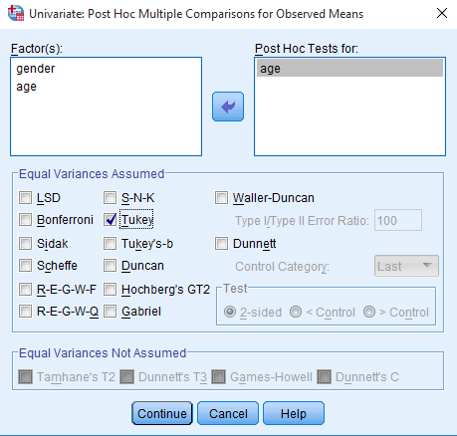
SPSS Path for Post Hoc Analysis
Exhibit 11.4. Click Post Hoc » Select » age and transfer in box Post Hoc Tests for » Select Tukey as test of Equal Variance Assumed » Continue

Slide 21
Interpreting Outputs of Two-Way ANOVA
Identification of Labels
Table 11.5. Between-Subjects Factors: Two-Way ANOVA
 |  | Value Label | N
Gender | 1.00 | Male | 40
 | 2.00 | Female | 40
Age | 1.00 | 20–25 Years | 20
 | 2.00 | 25–35 Years | 20
 | 3.00 | 35–50 Years | 20
 | 4.00 | >50 Years | 20

Slide 22
Descriptors for Between-Subjects Factors
Dependent Variable: Friend
Gender | Age | Mean | Std. Deviation | N | Gender | Age | Mean | Std. Deviation | N
Male | 20–25 Years | 99.0 | 27.9 | 10 | Female | 20–25 Years | 100.5 | 47.2 | 10
 | 25–35 Years | 113.0 | 37.8 | 10 |  | 25–35 Years | 115.5 | 13.6 | 10
 | 35–50 Years | 64.5 | 21.5 | 10 |  | 35–50 Years | 75.5 | 25.8 | 10
 | >50 Years | 82.5 | 50.4 | 10 |  | >50 Years | 25.0 | 12.6 | 10
 | Total | 89.7 | 39.2 | 40 |  | Total | 79.1 | 44.2 | 40

Slide 23
Equality of Variance
Table 11.6. Levene’s Statistics: Two-Way ANOVA
F | df1 | df2 | Sig.
1.58 | 7 | 72 | 0.154
The p-value of Levene’s test as shown in the last column of Table 11.5c is more than 0.05 (p > 0.05, 0.154); hence, we fail to reject the null hypothesis and conclude that the condition of equal variance was fulfilled in the data set.

Slide 24
Tests of Between-Subjects Effects
Table 11.7. Tests of Between-Subjects Effects: Two-Way ANOVA
Dependent Variable: Friend
Source | Type III Sum of Squares | Df | Mean Square | F | Sig.
Corrected model | 62647.188ª | 7 | 8949.598 | 8.462 | 0.000
Intercept | 570375.313 | 1 | 570375.313 | 539.273 | 0.000
Gender | 2257.812 | 1 | 2257.812 | 2.135 | 0.148
Age | 45468.438 | 3 | 15156.146 | 14.330 | 0.000
gender * age | 14920.938 | 3 | 4973.646 | 4.702 | 0.005
Error | 76152.50 | 72 | 1057.674
Total | 709175.0 | 80
Corrected total | 138799.6 | 79
ªR Squared = 0.451 (Adjusted R Squared = 0.398)

Slide 25
As the p-values ‘Sig.’ (illustrated in last column) for gender is more than 5 per cent LoS (p > 0.05, 0.148), we fail to reject the null hypothesis of no effect of gender.
Thus, no significant difference occurs in number of friends between both the categories of gender.
The p-values of age (p < 0.05, 0.000) and gender x age (p < 0.05, 0.005) are less than the criterion value. Hence, we reject the null hypotheses of no effect of age and interaction effect.

Slide 26
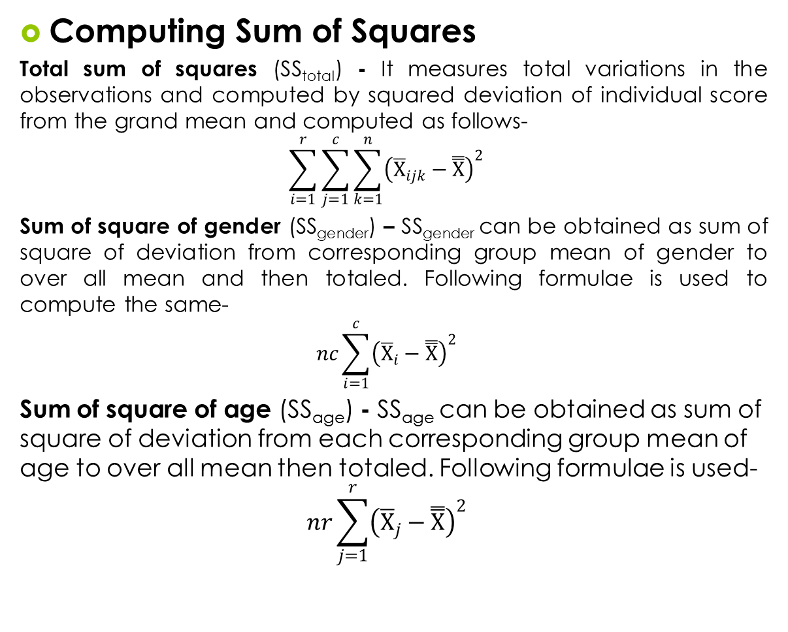
Important Calculations in Two-Way ANOVA

Slide 27
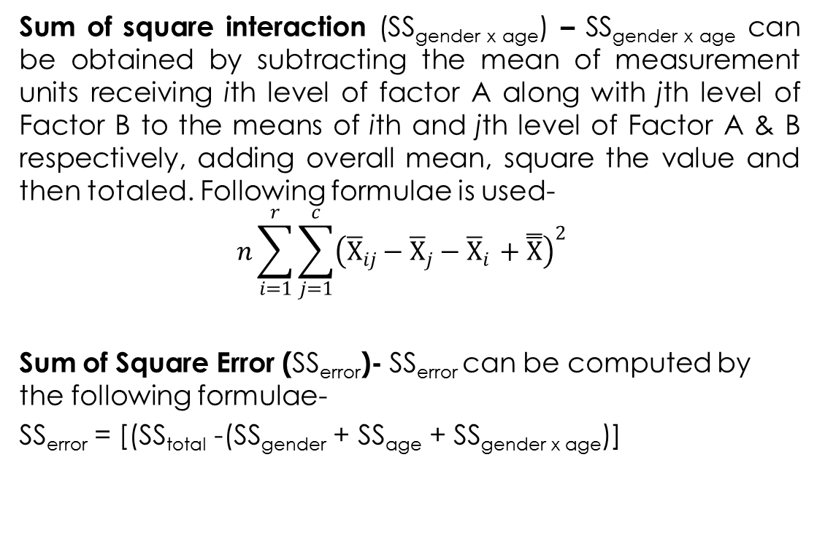

Slide 28
Computing Degrees of Freedom
Table 11.8. Degrees of Freedom: Two-Way ANOVA
Variation Source | Degrees of Freedom (df) | df
Factor A (gender) | Number of treatment − 1, (c−1) | 2−1 = 1
Factor B (age) | Number of treatment − 1, (r−1) | 4−1 = 3
Interaction (A×B) | (c−1) × (r−1) | 1×3 = 3
Error | rc (n*−1) | 8×9 = 72
Total variance | N**−1 | 80−1 = 79

Slide 29
Computing Mean Sum of Squares and F-Ratios
Table 11.9. F-Ratios: Two-Way ANOVA
Mean Sum of Square | Calculated Value | F-Ratios | Calculated Value
Ms_{gender} = SS_{gender}/df | 2257.8/1 = 2257.8 | F_{gender} = MS_{gender}/ Ms_{error} | 2257.8/1057.6 = 2.13
Ms_{age} = SS_{age}/df | 45468.4/3 = 15156.1 | F_{age} = MS_{age}/ Ms_{error} | 15156.1/1057.6 = 14.33
MS_{gender x age} = SS_{gender}/df | 14920.9/3 = 4976.64 | F_{gender x age} = MS_{ggender x age}/ Ms_{error} | 4976.3/1057.6 = 4.70
Ms_{erro} = SS_{error}/df | 76152.5/72 = 1057.6

Slide 30
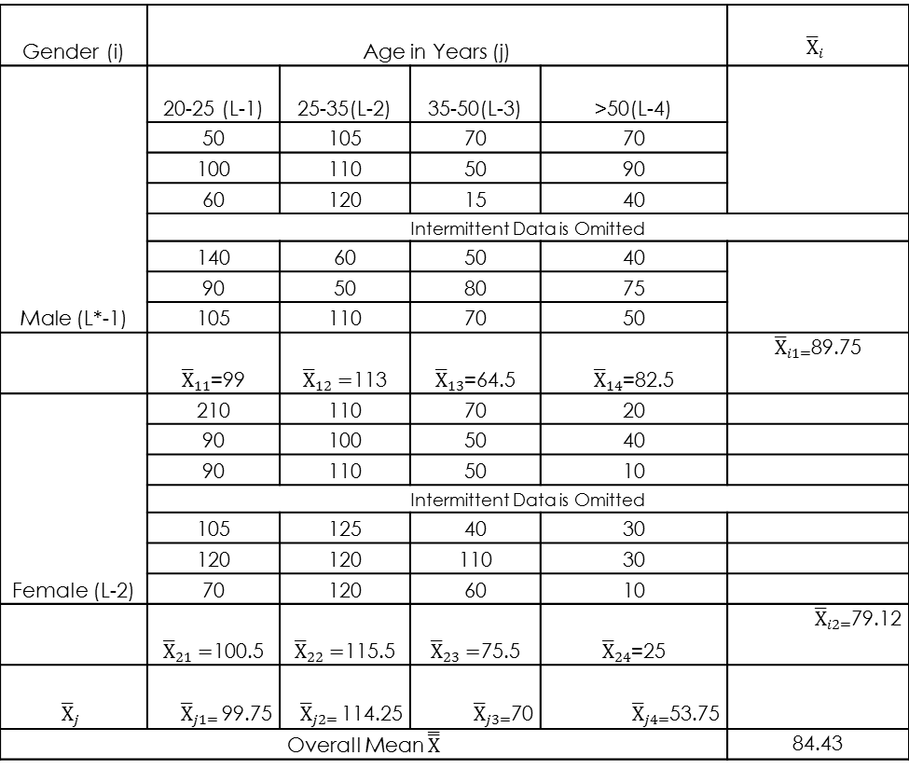
Sample Data Showing Mean Scores
Table 11.10. Different Mean Scores: Two-Way ANOVA
Gender (i) | Age in Years (j)
Male (L*−1) | 20−25 (L−1) | 25−35(L−2) | 35−50(L−3) | >50(L−4)
 | 50 | 105 | 70 | 70
 | 100 | 110 | 50 | 90
 | 60 | 120 | 15 | 40
 | Intermittent data is omitted
 | 140 | 60 | 50 | 40
 | 90 | 50 | 80 | 75
 | 105 | 110 | 70 | 50
Female (L−2) | 210 | 110 | 70 | 20
 | 90 | 100 | 50 | 40
 | 90 | 110 | 50 | 10
 | Intermittent data is omitted
 | 105 | 125 | 40 | 30
 | 120 | 120 | 110 | 30
 | 70 | 120 | 60 | 10
 |  |  |  |  | 84.43

Slide 31
Estimated Marginal Means
Main effect of Gender
Main Effect of Age
Gender | Mean | Gender | Mean
Male | 89.750 | Female | 79.125
Age | Mean | Age | Mean
20–25 years | 99.7 | 35–50 years | 70.0
25–35 years | 114.2 | >50 years | 53.7

Slide 32
Interaction Effect of Gender and Age
Gender | Age | Mean | Gender | Age | Mean
Male | 20–25 Years | 99.000 | Female | 20–25 Years | 100.500
 | 25–35 Years | 113.000 |  | 25–35 Years | 115.500
 | 35–50 Years | 64.500 |  | 35–50 Years | 75.500
 | >50 Years | 82.500 |  | >50 Years | 25.000

Slide 33
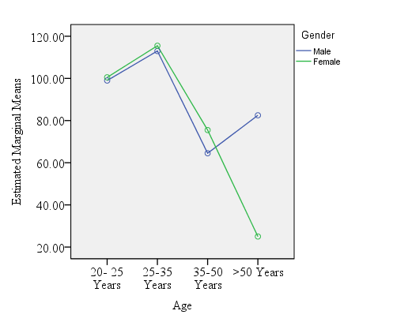
Displaying Interaction Effect
The interaction is called disordinal interaction as the lines are not parallel but crossed to each other as shown in the Figure.
The interaction effect without crossing the lines is called ordinal interaction.

Slide 34
Post Hoc Analysis
Table 11.11. Post Hoc Analysis: Two-Way ANOVA
(I) age | (J) age | Mean Difference (I–J) | Std. Error | Sig.
20–25 Years | 25–35 Years | −14.5 | 10.2 | 0.497
 | 35–50 Years | 29.75* | 10.2 | 0.025
 | >50 Years | 46.0* | 10.2 | 0.000
25–35 Years | 20–25 Years | 14.50 | 10.2 | 0.497
 | 35–50 Years | 44.25* | 10.2 | 0.000
 | >50 Years | 60.50* | 10.2 | 0.000
35–50 Years | 20–25 Years | −29.75* | 10.2 | 0.025
 | 25–35 Years | −44.25* | 10.2 | 0.000
 | >50 Years | 16.25 | 10.2 | 0.396
>50 Years | 20–25 Years | −46.0* | 10.2 | 0.000
 | 25–35 Years | −60.5* | 10.2 | 0.000
 | 35–50 Years | −16.25 | 10.2 | 0.396

Slide 35
Reporting the Results of Two-Way ANOVA
The p-value associated with one-sample KS is more than 5 per cent LoS (K-S Z = 0.086, p > 0.05, 0.200), hence we fail to reject the null hypothesis indicating the condition of normality.
Similarly, as the p-values associated with F-statistic of factor-A [F_{gender} (1,72) = 2.13, p > 0.05, 0.148)] is more than 5 per cent LoS, we fail to reject the null hypothesis of confirming the main effect of gender.
Likewise, the p-values associated with F-statistic of factor-B [F_{age}(1,72) = 14.33, p < 0.05, 0.000)] is less than 5 per cent LoS, hence we reject the null hypothesis of main effect of age.

Slide 36
The p-values associated with F-statistic of interaction [F_{gender x age} (3,72) = 4.7, p < 0.05, 0.005)] is less than 5 per cent LoS, hence we reject the null hypothesis of interaction due to the joint effect of both gender and age.
In case of multiple comparison analysis, the results of Tukey HSD indicates that number of friends in two pairs 20–25 years: 25–35 years (p > 0.05, 0.497) and 35–50 years: >50 years (p > 0.05, 0.396) are insignificant.

Slide 37
Key Terms
F-ratios Homogeniety of varaince Interaction effect Main effect Mean sum of square Profile plot Post hoc analysis | Sum of Square between sample Sum of Square within sample Tukey HSD Two-factorial design

